Slide 1
Unsupervised Learning
James Bennett

Slide 2
PURPOSE
The purpose of today's project is to describe Unsupervised Learning, and to demonstrate different algorithms which may be used to achieve the goal of gathering data via scatterplot.

Slide 3
What is Unsupervised Learning
Unsupervised learning is the area of machine learning that finds interesting patterns in data.
Unsupervised learning uses unlabeled data, which represents raw information, to find patterns or to group data. To break this down into steps, the process first interprets the unlabeled data, then uses an algorithm to process the data, and finally creates the output of groups by characteristic.
10.2.2: Exploring Unlabeled Data: Bootcamp: UNCC-VIRT-FIN-PT-09-2022-U-B-TTH (bootcampspot.com)

Slide 4
WHAT IS SCIKIT LEARN
This open source library for Python programming offers several algorithms for supervised and unsupervised learning. 10.2.3: Using the K-Means Algorithm for Customer Segmentation: Bootcamp: UNCC-VIRT-FIN-PT-09-2022-U-B-TTH (bootcampspot.com)
Some Algorithms include:
Regression
Clustering
Classification
Examples of different algorithms linked below.
scikit-learn: machine learning in Python — scikit-learn 1.2.0 documentation

Slide 5
Encoding
Sometimes data needs to be converted into numerical functions.
Categorical Data is typically the type of data which describe information which can be converted into boolean, thus turning this information into One’s and Zero’s.
Encoding is used as a technique to read Categorical Data.

Slide 6
DIFFERENT ALGORITHMS
K Means-unsupervised learning method for clustering data points. The algorithm iteratively divides data points into K clusters by minimizing the variance in each cluster.
Affinity Propagation- affinity propagation: An algorithm that identifies exemplars among data points and forms clusters of data points around these exemplars. It operates by simultaneously considering all data point as potential exemplars and exchanging messages between data points until a good set of exemplars and clusters emerges.
DBSCAN- represents Density-Based Spatial Clustering of Applications with Noise. It is a density-based clustering algorithm. The algorithm improves regions with adequately high density into clusters and discovers clusters of arbitrary structure in spatial databases with noise. It defines a cluster as a maximum set of density-connected points. DBSCAN Clustering — Explained. Detailed theorotical explanation and… | by Soner Yıldırım | Towards Data Science

Slide 7
CLUSTERING K-MEANS ALGORITHM EXAMPLE
Customers clustering: K-Means, DBSCAN and AP | Kaggle
This project shows how to perform a mall customers segmentation using Machine Learning algorithms. This is the unsupervised clustering problem and three popular algorithms will be presented and compared: KMeans, Affinity Propagation and DBSCAN.
NOTE: This is NOT my work

Slide 8
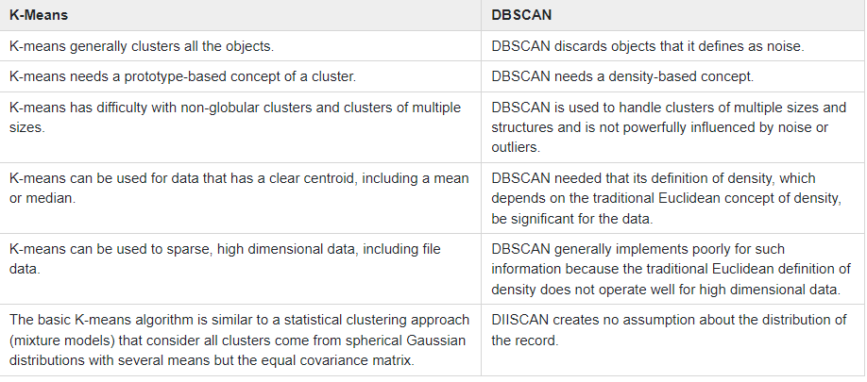
K-MEANS, DBSCAN COMPARISON
What is the difference between K-Means and DBSCAN? (tutorialspoint.com)

